Slide 1
Operating System(22516) Unit-6 File Management Marks: 10
Prepared by:
Mrs. Kousar Ayub A.
Lecturer(Selection Grade)
Computer Engg. Dept
M. H. Saboo Siddik Polytechnic

Slide 2
Learning Outcomes
The learners will be able to:
Basic File management.
Different File Access Methods.
Directory structure.

Slide 3
File
A file is a named collection of related information that is recorded on secondary storage such as magnetic disks, magnetic tapes and optical disks.
Commonly files represent programs (source and object forms) and data. Data files may be numeric alphabetic, alphanumeric or binary.
In general a file is a sequence of bits, bytes lines or records whose meaning is defined by the file’s creator and user. The information in a file is defined by its creator.
Many different types of information may be stored in a file: Source programs, Object programs, Executable programs, Numeric Data, Text, Payroll records, Graphic Images, Sound recording and so on.

Slide 4
File Attributes
Name: The symbolic file name is the only information kept in human readable form.
Type: This information is needed for those systems that support different types.
Location: This information is a pointer to a device and to the location of the file on that device.
Size: The current size of the file (in bytes, words or blocks) and possibly the maximum allowed size are included in this attribute.
Protection: Access control information controls that who can do reading, writing, executing and so on.
Time, Date and User Identification: This information may be kept for creation, Last modification and last use. These data can be useful for protection, security and usage monitoring.
Identifier: File system gives a unique tag or number that identifies file within file system and which is used to refer files internally.
Creator or Owner: A creator is a user or a person who has created that file and the owner is a person who owns that file currently.

Slide 5
File Operations
Creating a file: Two steps are necessary to create a file. First space in the file system must be found for the file
Second an entry for the new file must be made in the directory. The directory entry records the name of the file and the location in the file system.
Writing a file: To write a file, we make a system call specifying both the name of the file and the information to be written to the file. Given the name of the file, the system searches the
directory to find the location of file then the write pointer must be updated whenever a write occurs
Reading a file: To read from a file, we use a system call that specifies the name of the file and where (in memory) the next block of the file should be put. System needs to keep a read pointer to location in the file where the next read is to take place. Once the read has taken place, the read pointer is updated.

Slide 6
File Operations
Repositioning within a file: The directory is searched for the appropriate entry, and the current file position is set to a given value. Repositioning within a file does not need to involve any actual I/O. This file operation is also known as a file seeks.
Deleting a file: To delete a file, we search the directory for the named file. Having found the associated directory entry, we release all file space and erase the directory entry.
Truncating a file: Instead of deleting a file and then recreate it, this function allows all attributes to remain unchanged but for the file to be reset to length zero. User wants to erase the contents of the file.
Other common operations include appending new information to the end of an existing file, and renaming an existing file.

Slide 7
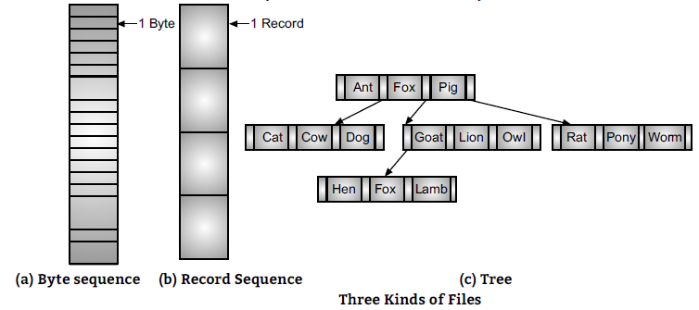
File Structure

Slide 8
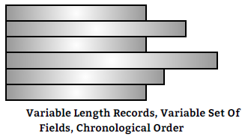
Serial File
The least complicated form of file organization is the serial file or pile. Data are collected in the order in which they arrive.
The purpose of this file is simply accumulating the mass of data and save it. Records may have different fields, or similar fields in different orders. Thus, each field should be self describing including a field name as well as a value.

Slide 9
Serial File
Advantages of Serial File:
1. Simple organization.
2. Data usually stored prior to processing.
3. Less complexity and good efficiency for variable sized record.
4. Utilizes space very well for varying data structure.
Disadvantages of Serial File:
1. Because there is no structure to these file, record access is very difficult.
2. Required more searching time.
3. Records are not arrange in proper manner.

Slide 10
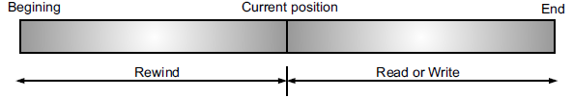
Sequential File Access
The simplest access method is sequential access. Information in the file is processed in order, one record after the other.
The bulk of the operations on a file are reads and writes. The read and write operations on the sequential file are done in sequential order.
A read operation reads the next portion of the file and automatically advances a file pointer, which tracks the I/O location. Similarly a write appends to the end of the file and advances to the end of the newly written material.
Such a file can be reset to the beginning and on some systems a program may be able to skip forward or backward ‘n’ records for some integer ‘n’.

Slide 11
Sequential File Access
Advantages of Sequential File:
1. Easy to access the next record.
2. Data organization is very simple.
3. Absence of data structures.
4. They are easily stored on tapes as well as disks.
5. Automatic backup copy is created.
Disadvantages of Sequential File:
1. Wastage of memory space because of master file and transaction file.
2. For interactive applications that involve queries and/or updates of individual records, the
sequential file provides poor performance.
3. It is more time consuming since, reading, writing and searching always start from beginning of file.

Slide 12
Index Sequential File
These additional methods generally involve the construction of an index for the file. The index, like an index in the back of a book, contains pointers to the various blocks. To find an entry in the file we first search the index and then use the pointer to directly access the file and find the desired entry. From this search we would know exactly which block contains the desired entry and access that block. This structure allows us to search a large file with very little Input/Output.
With large files, the index file itself may become too large to be kept in memory. One solution is then to create an index for the index file. The primary index file would contain pointers to secondary index files, which then point to the actual data items.

Slide 13
Index Sequential File
Advantages:
Variable length records are allowed.
Indexed sequential file may be updated in sequential or random mode
Very fast operation
Disadvantages:
The major disadvantage of the index sequential file is that as the file grows, a performance deteriorates rapidly because of overflows and consequently there arises the need for periodic reorganization. Reorganization is an expensive process and the file becomes unavailable during reorganization.
When a new record is added to the main file, all of the index files must be updated.
Consumes large memory space for maintaining index files.

Slide 14
Direct Access
For direct access the file is viewed as a number sequence of blocks of records. A block is generally a fixed length quantity, defined by operating system. A block may be a byte 512 words, 1024 bytes or some other quantity, depending upon the system.
A direct access file allows arbitrary blocks to be read or written. Thus we may read block 14, then read block 50 and then write block 7. There are no restrictions on the order of reading or writing for a direct access file.
Direct access files are of great use for immediate access to large amounts of information. When a query concerning a particular subject arrives, we compute which block contains the answer and then read the block directly to provide the desired information. Not all the operating system support both sequential and direct access of files. Some systems allow only sequential file access, others allow only direct access.

Slide 15

Direct Access
Advantages of Direct File Access:
1. Using this method we can access any records randomly.
2. It gives fastest retrieval of records.
Disadvantages of Direct File Access:
1. Wastage of storage space, if hashing algorithm is not chosen properly.
2. This method is complex and expensive.

Slide 16
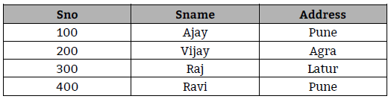
Hashing
The basic idea of Hash addressing is that each record is placed in the database at a location whose address (SRA (Stored Record Address)) may be computed as some function (called as Hash function) of a value usually the primary key value.
Thus, to store the record initially the system computes SRA and instructs the access method to place the occurrence at that position and to retrieve the occurrence the DBMS performs the same computation as before and then requests the access method to fetch the occurrence at the computed position.
We will take a simple hashing function is h (k) = k mod s.

Slide 17
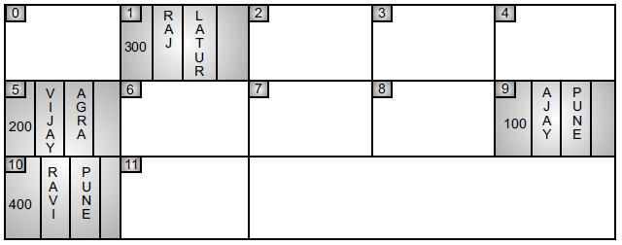
Hashing
SRA = S No. Mod 13
The SRA = Stored record address is the remainder of the above operation example for SNo 100, SRA = 9, next is 5, 1, 10.

Slide 18
Swapping
Swapping is a mechanism in which a process can be swapped temporarily out of main memory (or move) to secondary storage (disk) and make that memory available to other processes. At some later time, the system swaps back the process from the secondary storage to main memory.
The Resident Monitor memory management scheme may seem of little use since it appears to be inherently single user. These systems used a resident monitor with the remainder of memory available to the currently executing user.
When they switched to the next user, the current contents of user memory were written out to a backing store (a disk or drum) and the memory of the next user was read in. This scheme is called Swapping.

Slide 19
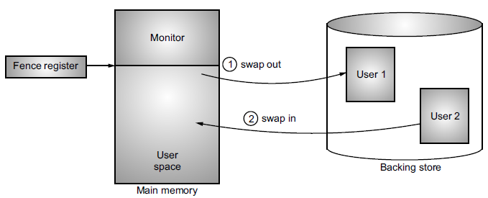
Swapping

Slide 20
Allocation methods
From the user’s point of view, a file is an abstract data type. It can be created, opened, written, read, closed and deleted without any real concern for its implementation. The implementation of a file is a problem for the operating system.
The main problem is how to allocate space to these files so that disk space is effectively utilized and files can be quickly accessed.
Three major methods of allocating disk space are in wide use:
Contiguous
Linked
Indexed
Each method has its advantages and disadvantages.

Slide 21
Contiguous Allocation
The contiguous allocation method requires each file to occupy a set of contiguous addresses on the disk. Disk addresses define a linear ordering on the disk. Contiguous allocation of a file is defined by the disk address of the first block and its length. If the file is ‘n’ blocks long and starts at location ‘b’, then it occupies blocks b, b+1, b+2, - - - - - b+n-1. The directory entry for each file indicates the address of the starting block and the length of the area allocated for this file.
Contiguous allocation supports both sequential and direct access.
For direct access to block ‘i’ of a file, which starts at block ‘b’, we can immediately access block b+i. The difficulty with contiguous allocation is finding space for a new file.
For direct access to block ‘i’ of a file, which starts at block ‘b’, we can immediately access block b+i.
The difficulty with contiguous allocation is finding space for a new file.
If file to be created are ‘n’ blocks long, we must search free space list for ‘n’ free contiguous blocks.

Slide 22
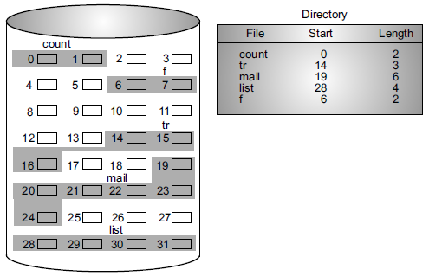
Contiguous Allocation

Slide 23
Contiguous Allocation
Advantages of Contiguous File Allocation Method:
1. Supports both sequential and direct access methods.
2. Contiguous allocation is the best form of allocation for sequential files. Multiple blocks can be
brought in at a time to improve I/O performance for sequential processing.
3. It is also easy to retrieve a single block from a file. For example, if a file starts at block ‘n’ and the ith block of the file is wanted, its location on secondary storage is simply n + i.
4. Reading all blocks belonging to each file is very fast.
5. Provides good performance.
Disadvantages of Contiguous File Allocation Method:
1. Suffers from external fragmentation.
2. Very difficult to find contiguous blocks of space for new files.
3. Also with pre-allocation, it is necessary to declare the size of the file at the time of creation which many a times is difficult to estimate.
4. Compaction may be required and it can be very expensive.

Slide 24
Linked File Allocation (Chained File Allocation)
With linked allocation, each file is a linked list of disk blocks; the disk blocks may be scattered any where on the disk. The directory contains a pointer to the first (and last) blocks of the file. For example a file of 5 blocks, which starts at block 9 might continue at block 16, then block 1, block 10, and finally block 25. Each block contains a pointer to the next block. These pointers are not made available to the user, thus if sector is 512 words and a disk address (the pointer) requires two words, then the user sees blocks of 510 words.
Creating a file is easy. We simply create a new entry in the device directory. A write to a file removes first free block from free space list and write to it. This new block is then linked to the end of the file. To read a file, we simply read block by following the pointers from block to block. There is no external fragmentation with linked allocation

Slide 25
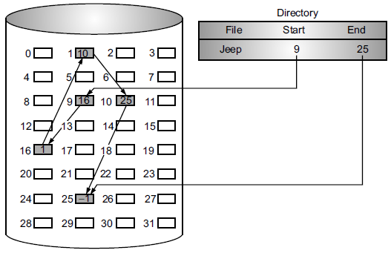
Linked File Allocation (Chained File Allocation)

Slide 26
Linked File Allocation (Chained File Allocation)
Advantages of Linked File Allocation Method:
1. Any free blocks can be added to a chain.
2. There is no external fragmentation.
3. Best suited for sequential files that are to be processed sequentially.
4. No need to know the size of the file in advance.
5. No need to compact or relock files.
Disadvantages of Linked File Allocation Method:
1. There is no accommodation of the principle of locality that is series of accesses to different parts of the disk are required.
2. Space is required for the pointers, 1.5% of disk is used for the pointers and not for information. If a pointer is lost or damaged or bug occurs in operating system or disk hardware failure occur, it may result in picking up the wrong pointer.
3. This method cannot support direct access.

Slide 27
Indexed File Allocation
Linked allocation solves the external fragmentation and size declaration problems of contiguous allocation. However linked allocation cannot support direct access, since the blocks are scattered all over the disk.Mostly pointers to blocks are scattered all over the disk.
Indexed allocation solves this problem by bringing all of the pointers together into one location the Index Block.
Each file has its own index block, which is an array of disk block addresses. The ith entry in the index block points to the ith block of the file. The directory contains the address of the index block.
To read the ith block we use pointer in ith index block entry to find and read the desired block. When the file is created, all pointers in the index block are set to nil. When the ith block is first written a lock is removed from the free space list and its address is put in the ith index block entry.

Slide 28
Indexed File Allocation
Indexed allocation supports direct access, without suffering from external fragmentation. Indexed allocation does suffer from wasted space. The pointer overhead of index block is worse than pointer over head of linked allocation. Assume we have a file of only one or two blocks with linked allocation we only lose the space of one pointer per block. With indexed allocation an index block must be allocated even if only one or two pointers will be non-nil.

Slide 29
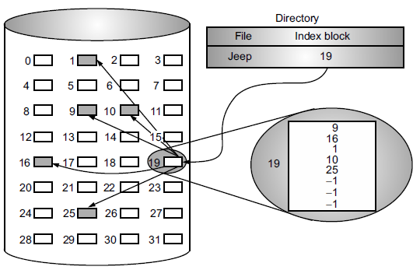
Indexed File Allocation

Slide 30
Indexed File Allocation
Advantages of Indexed File Allocation Method:
1. Does not suffer from external fragmentation.
2. Support both sequential and direct access to the file.
3. No need for user to know size of the file in advance.
4. Entire block is available for data as no space is occupied by pointers.
Disadvantages of Indexed File Allocation Method:
1. It required lot of space for keeping pointers so wasted space of memory.
2. Overhead of index blocks is not feasible for very small file.
4. Overhead of index blocks is not feasible for very big file also, because it is difficult to manage
levels of indices.
5. Keeping index in memory requires space.

Slide 31
Single Level Directory Structure
It is the simplest form of directory system is having one directory containing all the files. Sometimes, it is called the root directory.
In single level directory structure, the entire files are contained in the same directory. So unique name must be assigned to each file of the directory
Single level directory structure was implemented in the older versions of single user systems.
The world’s first supercomputer, the CDC 6600, had only a single directory for all files, even though it was used by many users at once.

Slide 32
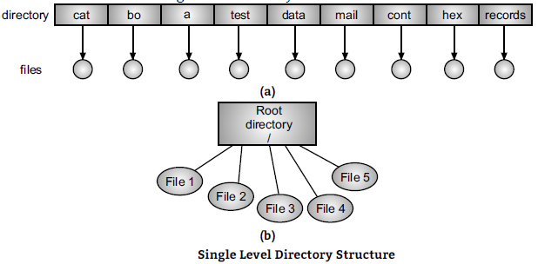
Single Level Directory Structure

Slide 33
Two Level Directory Structure
The structure of two level directory structure is divided into two levels of directories namely, a master directory and user directories. The user directories are the sub-directories of the master directory.
In two level directory structure, a separate directory is provided to each user and all these directories are contained and indexed in the master directory.
The user directory represents a list of files of a specific user. In this directory structure, each users has its private directory known as User File Directory (UFD).
The user directories themselves must be created and deleted as necessary. A special system program is run with the appropriate user name and account information. The program creates a new UFD and adds an entry for it to the Master File Directory (MFD). Thus the two level directories solve the name collision problem.

Slide 34
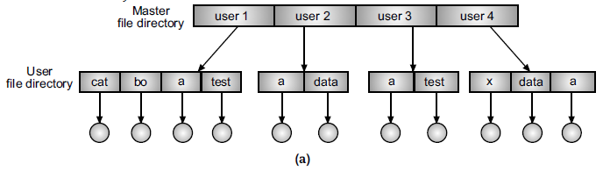
Two Level Directory Structure

Slide 35
Hierarchical Directory Structure (Tree Structure)
The two level hierarchies eliminate name conflicts among users but are not satisfactory for users with a large number of files. We needed general hierarchy i.e., a tree of directories.
The tree structured directory structure, allows users to create their own subdirectory and to organize their files accordingly. A subdirectory contains a set of files or subdirectories. A directory is simply another file, but it is treated in a special way.

Slide 36
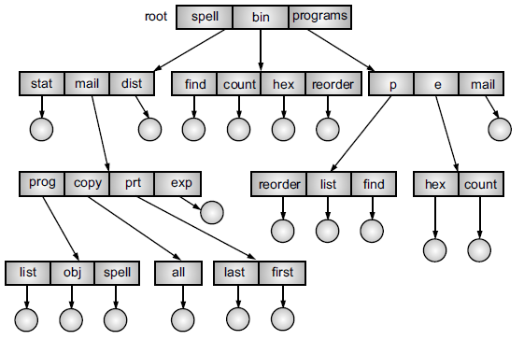
Hierarchical Directory Structure (Tree Structure)

Slide 37
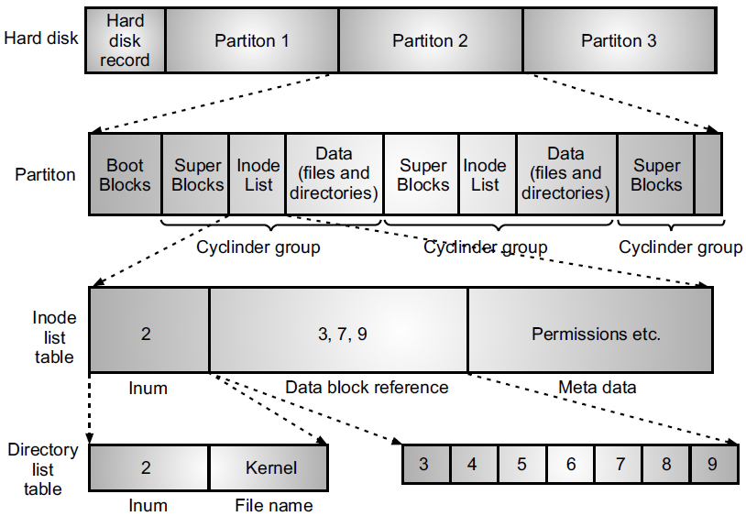
Disk management in Linux

Slide 38
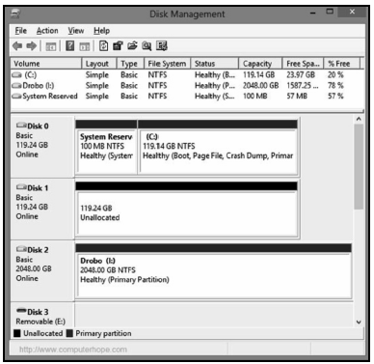
Disk Management in Windows OS

Slide 39
Measurement of speed of the disk
Transfer Rate is the rate at which the data moves from disk to the computer.
Random Access Time is the sum of the seek time and rotational latency.
The seek time is the time for the disk arm to move the head to the required cylinder containing the desired track.
The rotational latency is the additional time for the disk to rotate the desired sector to the disk head.
The disk bandwidth is the total number of bytes transferred, divided by the total time between the first request for service and the completion of the last transfer.

Slide 40
Thank you…..
You can mail your Queries to :
a2kousarj@gmail.com

